Slide 1


Slide 2

16
Public Goods

Slide 3
After studying this chapter you will be able to
Distinguish among private goods and public goods
Explain how the free-rider problem arises and how the quantity of public goods is determined
Copyright © 2013 Pearson Canada Inc., Toronto, Ontario

Slide 4
Why don’t we let private firms produce national defence or police services and sell their products in the market?
This is one of the big questions of this chapter.
Copyright © 2013 Pearson Canada Inc., Toronto, Ontario

Slide 5
Classifying Goods and Resources
  What Is a Public Good?
  What is the essential difference between:
  A city police department and Brink’s security?
  A live concert and a concert on television?
  These and all goods and services can be classified according to whether they are excludable or nonexcludable and rival or nonrival.

Slide 6
Classifying Goods and Resources
Excludable
  A good is excludable if only the people who pay for it are able to enjoy its benefits.
  Brink’s security services and a Coldplay concert are examples.
  Nonexcludable
  A good is nonexcludable if it is impossible (or extremely costly) to prevent anyone from benefiting from it.
  The services of the police and a concert on network television are examples.

Slide 7
Classifying Goods and Resources
Rival
  A good is rival if one person’s use of it decreases the quantity available for someone else.
  A Brink’s truck can’t deliver cash to two banks at the same time. A fish can be consumed only once.
  Nonrival
  A good is nonrival if one person’s use of it does not decrease the quantity available for someone else.
  The services of the police and a concert on network television are nonrival.

Slide 8
Classifying Goods and Resources
A Four-Fold Classification
  Private Goods
  A private good is both rival and excludable.
  A can of Coke is an example of a private good.
  Public goods
  A public good is both nonrival and nonexcludable. A public good can be consumed simultaneously by everyone, and no one can be excluded from its benefits.
  National defence is the best example of a public good.

Slide 9
Public Goods
The Free-Rider Problem
A free rider enjoys the benefits of a good or service without paying for it.
Because no one can be excluded from the benefits of a public good, everyone has an incentive to free ride.
Public goods create a free-rider problem—the absence of an incentive for people to pay for what they consume.

Slide 10
Public Goods
  The value of a private good is the maximum amount that a person is willing to pay for one more unit of it.
  The value of a public good is the maximum amount that all the people are willing to pay for one more unit of it.
  To calculate the value placed on a public good, we use the concepts of total benefit and marginal benefit.

Slide 11
Public Goods
Marginal Social Benefit of a Public Good
  Total benefit is the dollar value that a person places on a given quantity of a good.
  The greater the quantity of a good, the larger is a person’s total benefit.
  Marginal benefit is the increase in total benefit that results from a one-unit increase in the quantity of a good.
  The marginal benefit of a public good diminishes with the quantity of the good provided.

Slide 12
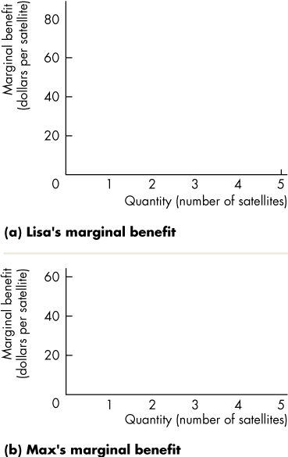
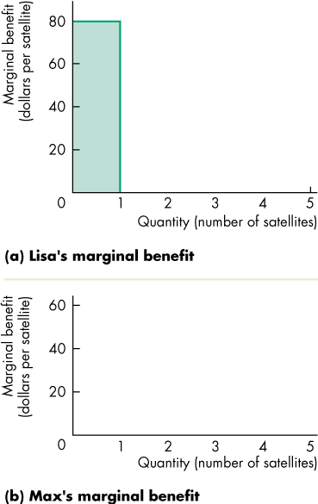
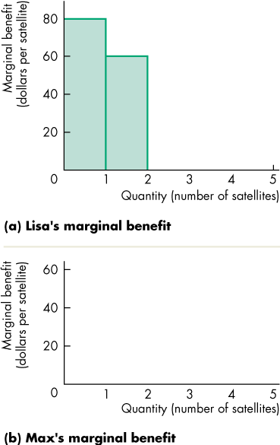
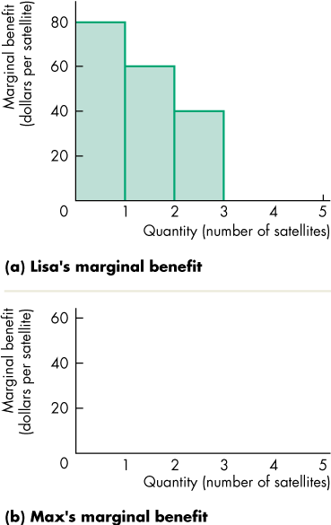
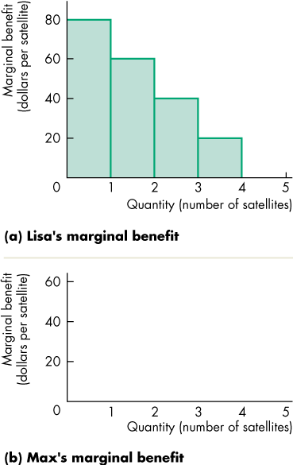
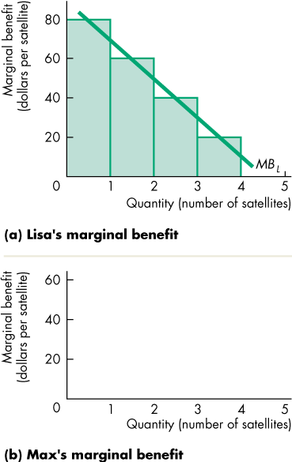
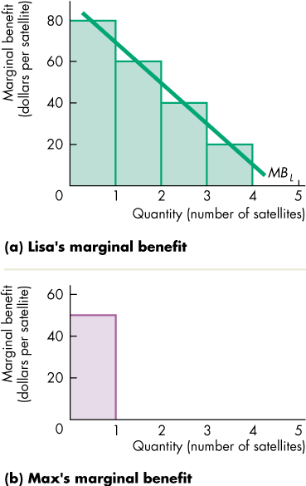
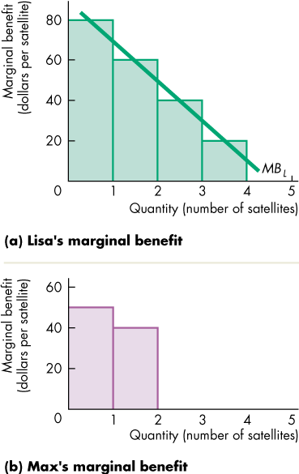
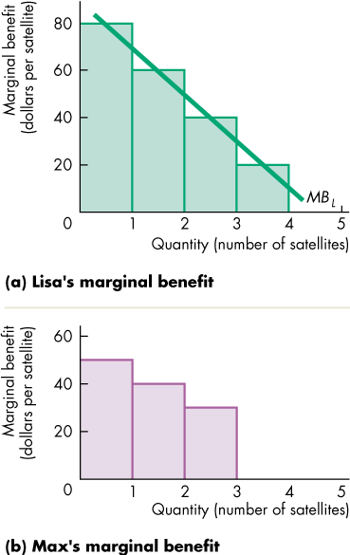
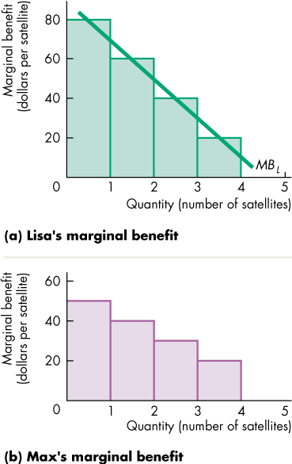
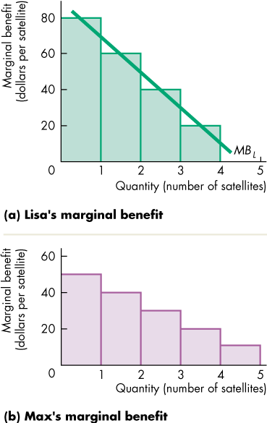
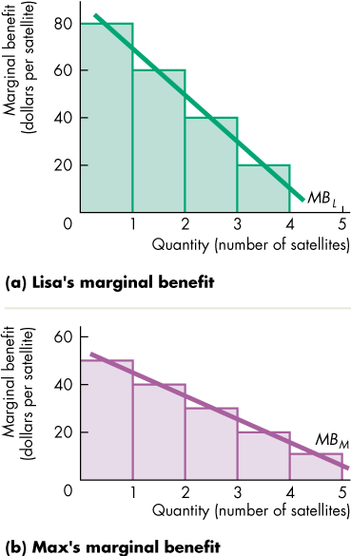
Public Goods
  The figure shows that the marginal social benefit of a public good is the sum of marginal benefits of everyone at each quantity of the good provided.
  Part (a) shows Lisa’s marginal benefit.
  Part (b) shows Max’s marginal benefit.

Slide 13
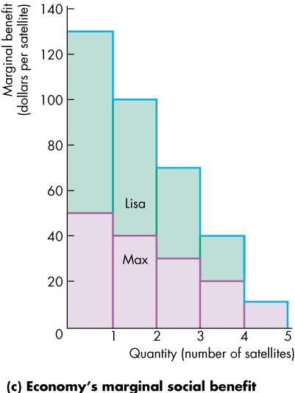
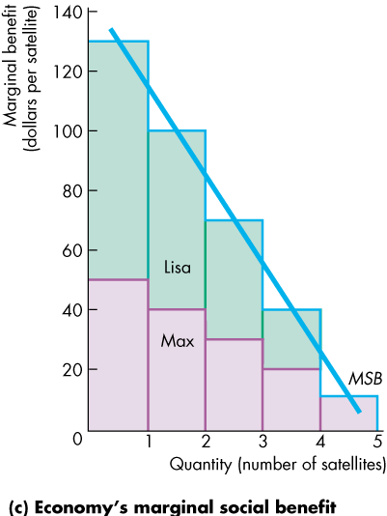
Public Goods
  The economy’s marginal social benefit of a public good is the sum of the marginal benefits of all individuals at each quantity of the good provided.
  The economy’s marginal social benefit curve for a public good is the vertical sum of all individual marginal benefit curves.

Slide 14
Public Goods
  The marginal social benefit curve for a public good contrasts with the demand curve for a private good, which is the horizontal sum of the individual demand curves at each price.

Slide 15
Public Goods
The Marginal Social Cost of a Public Good
The marginal social cost of a public good is determined in the same way as that of a private good.
The Efficient Quantity of a Public Good
  The efficient quantity of a public good is the quantity at which marginal social benefit equals marginal social cost.

Slide 16
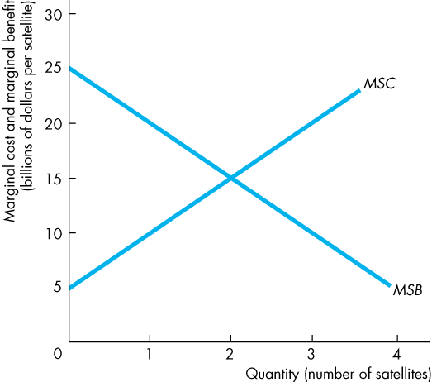
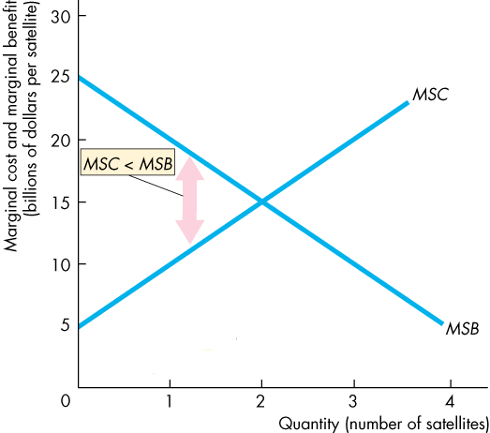
Public Goods
  The figure illustrates the efficient quantity of a public good.
  With fewer than
  2 satellites,
  MSB exceeds MSC.
  Resources a can be used more efficiently by increasing the quantity.

Slide 17
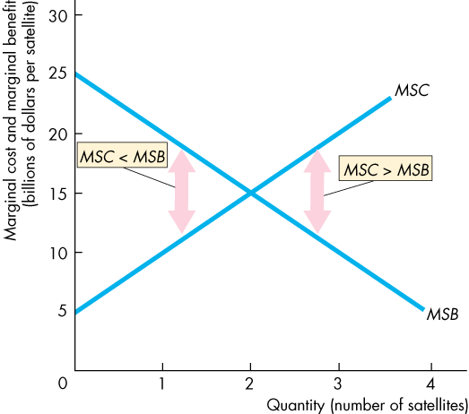
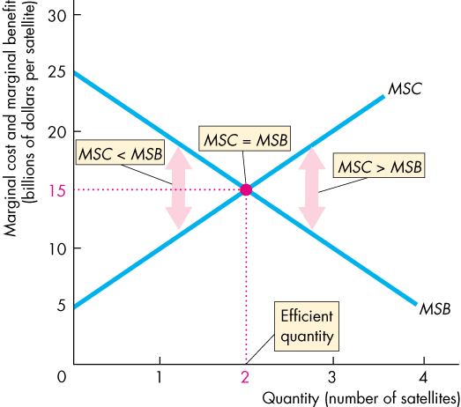
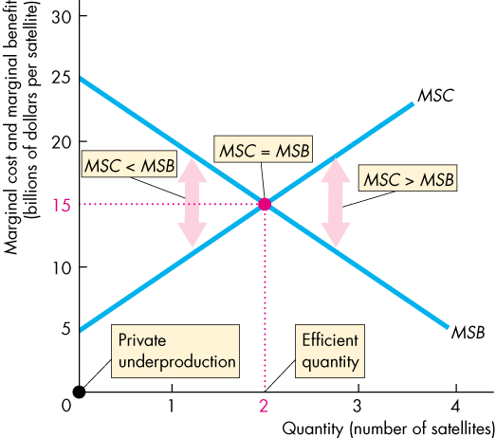
Public Goods
  With more than
  2 satellites,
  MSC exceeds MSB.
  Resources can be used more efficiently if fewer satellites are provided.
  So the quantity at which MSB = MSC, resources are used efficiently.
  Private production would produce 0 satellites.

Slide 18
Public Goods
Inefficient Private Provision
  If a private firm tried to produce and sell a public good, almost no one would buy it.
  The free-rider problem results in too little of the good being produced.

Slide 19
Public Goods
Efficient Public Provision
  Because the government can tax all the consumers of the public good and force everyone to pay for its provision, public provision overcomes the free-rider problem.

